Slide 1


Premium Quality Alaska White / Pink
M/s Kumar Herbals
bringing you
from the earth to your masterpiece

Slide 2
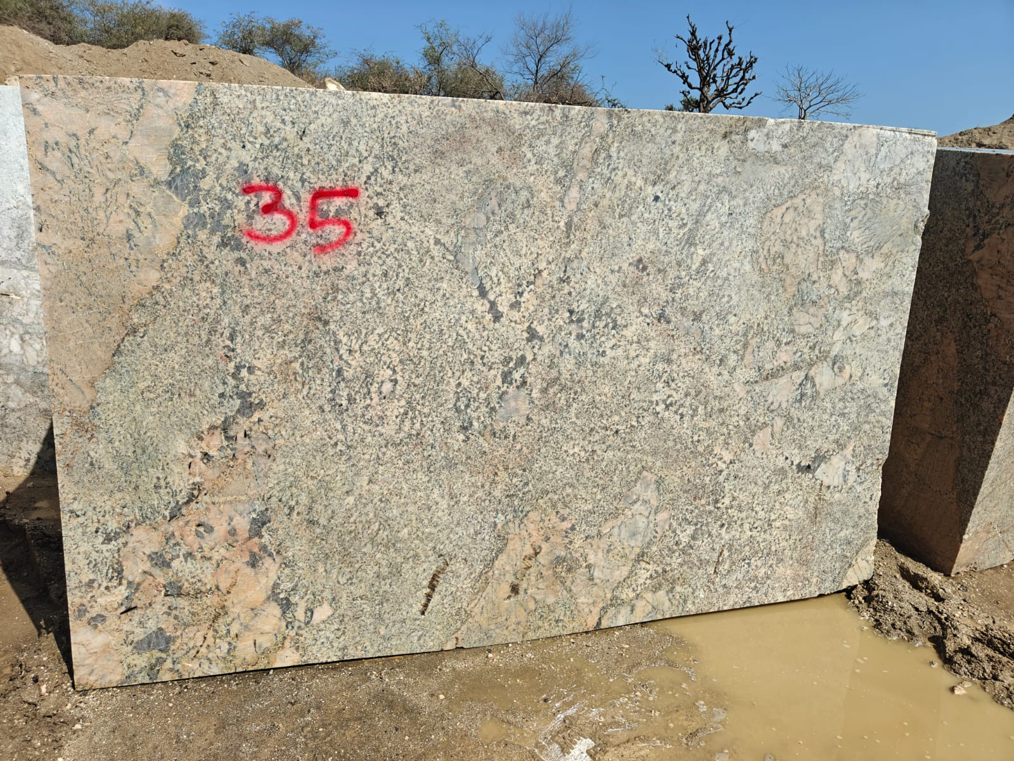
Alaska Pink

Slide 3
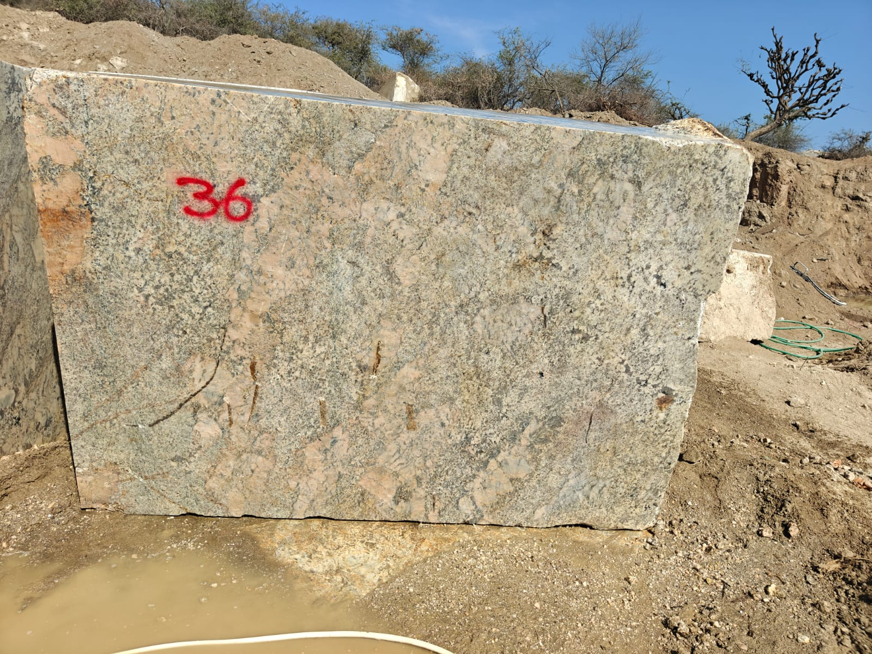
Alaska Pink

Slide 4
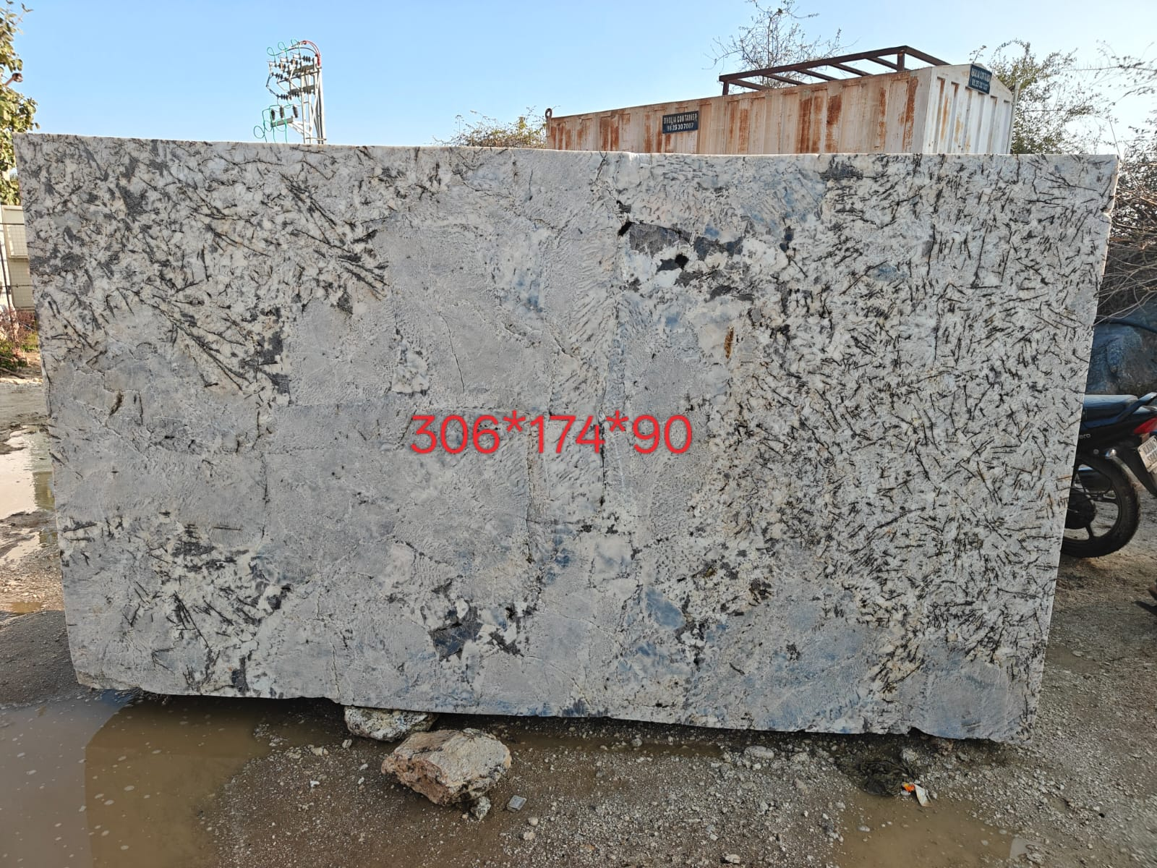
Alaska White

Slide 5
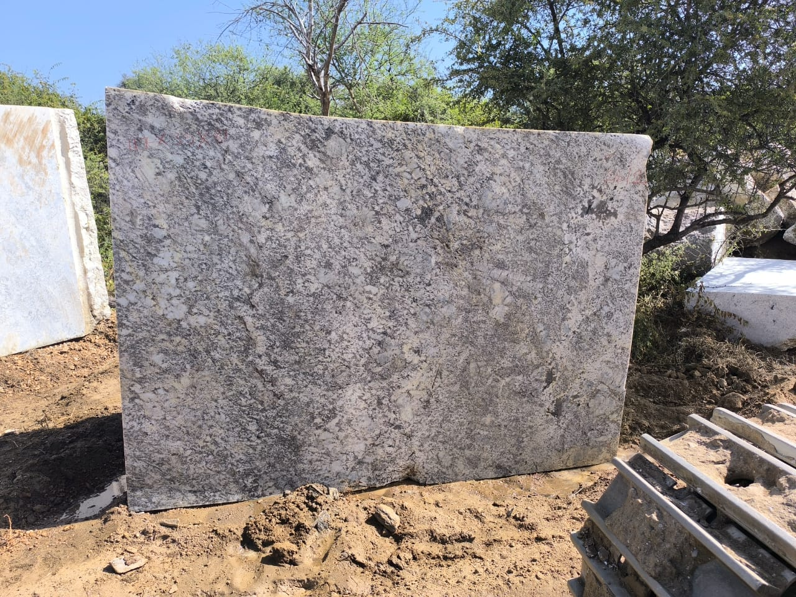
Alaska White

Slide 6
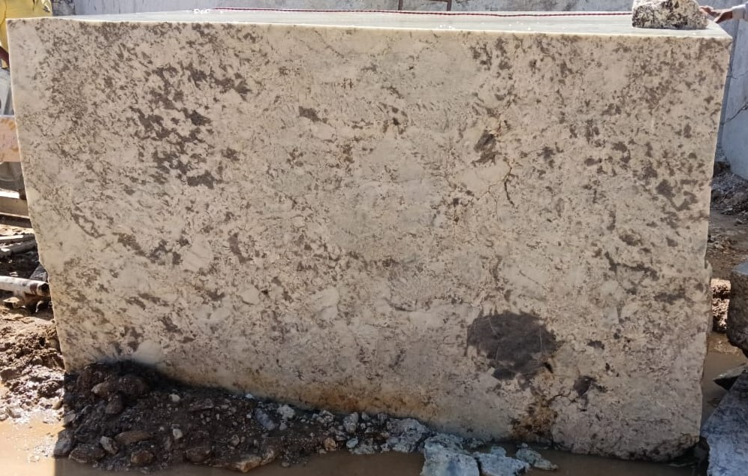
Alaska White

Slide 7
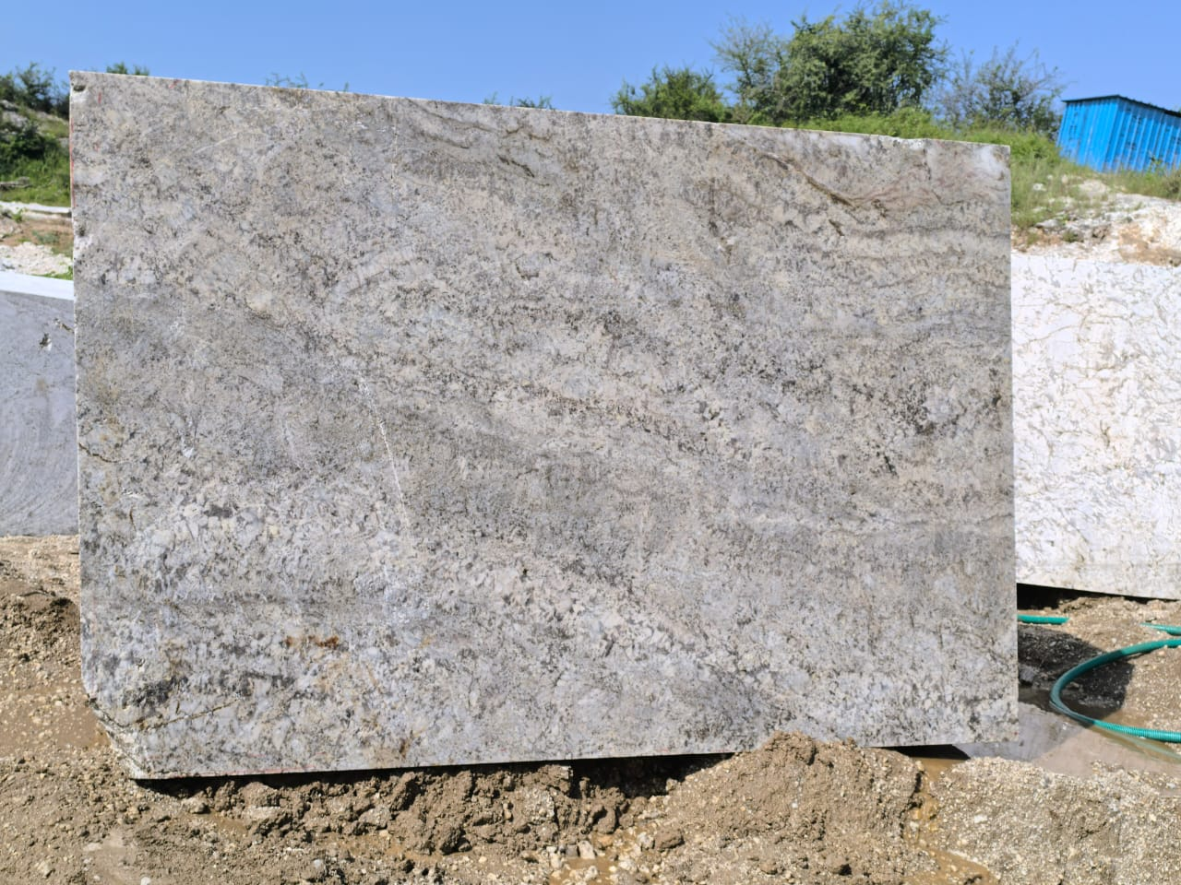
Alaska White

Slide 8
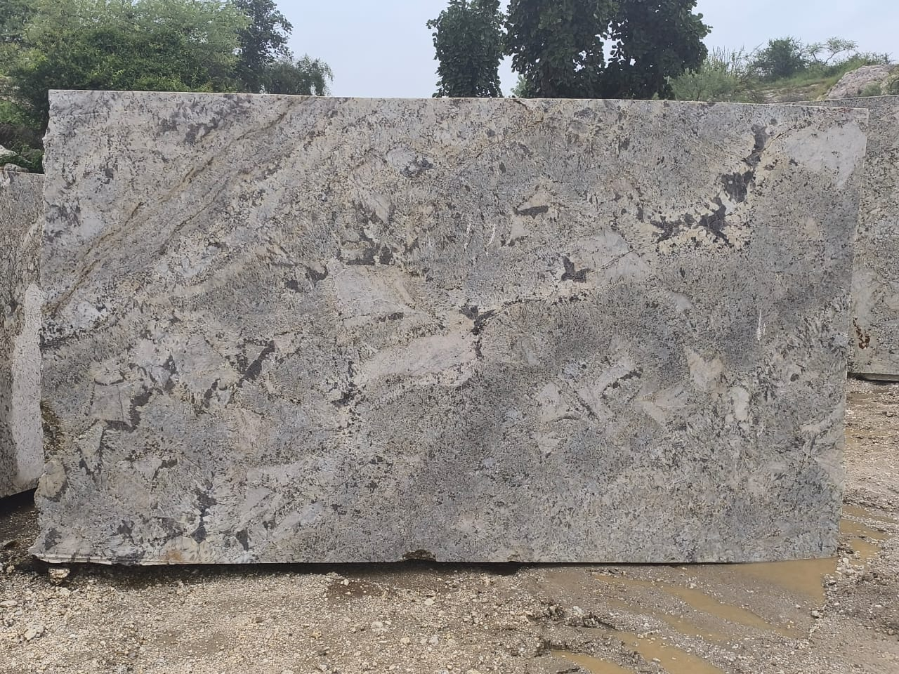
Alaska White

Slide 9
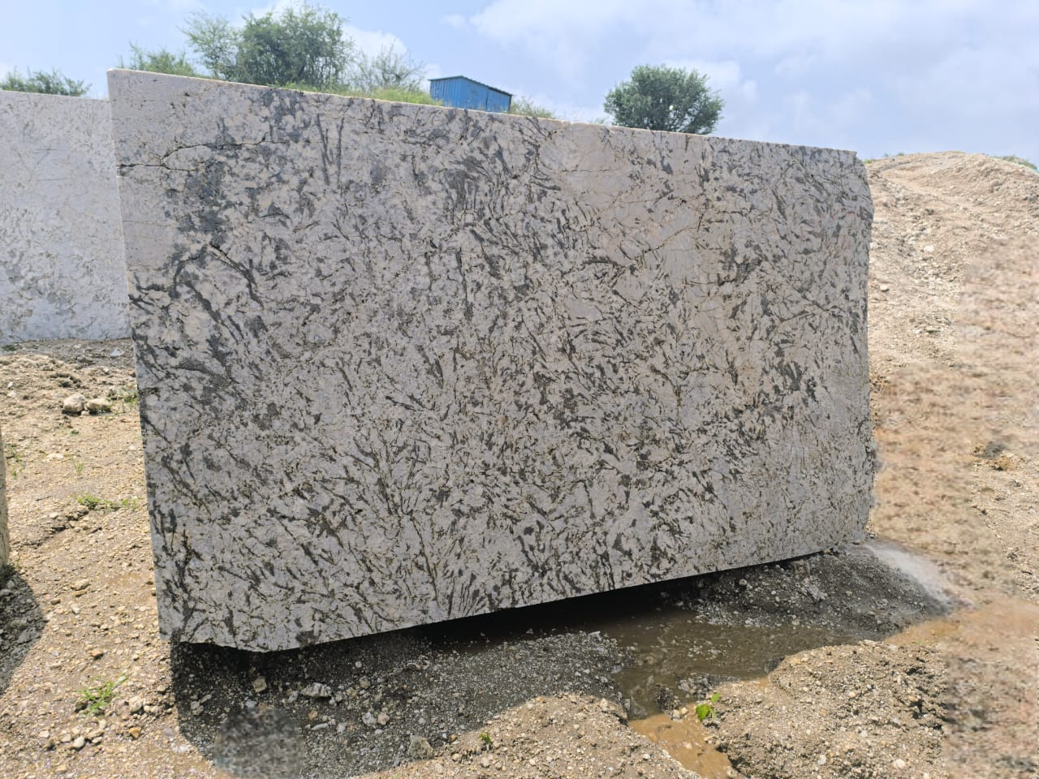
Alaska White

Slide 10
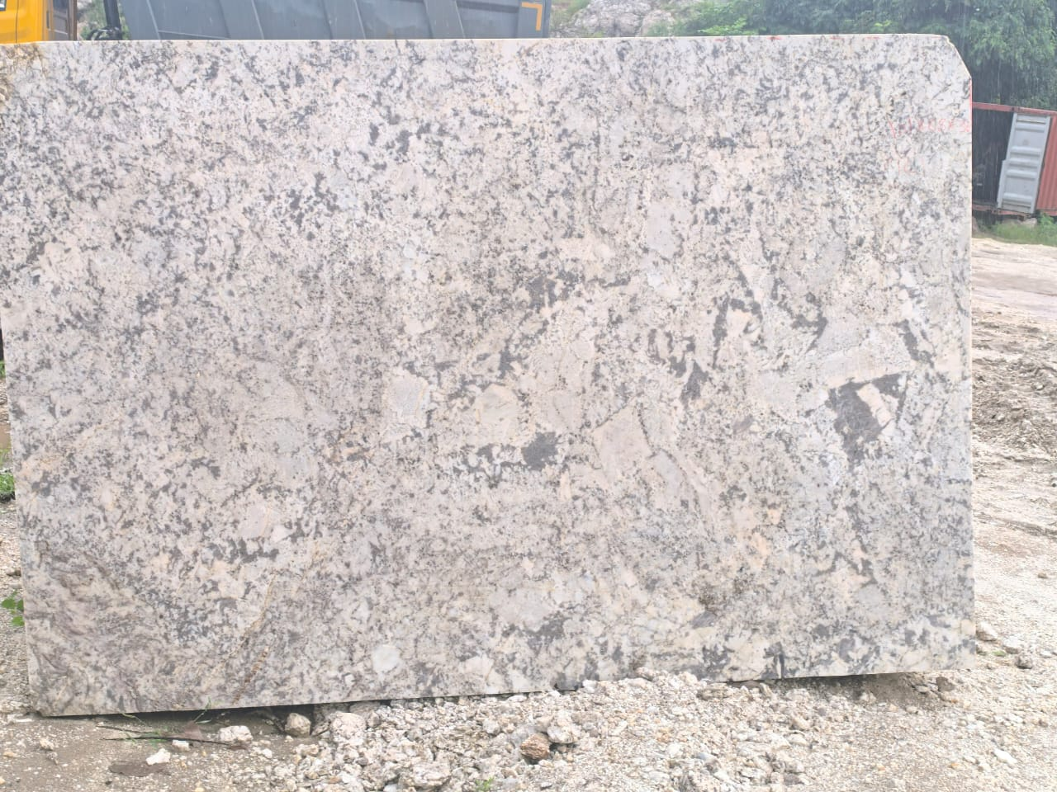
Alaska White

Slide 11
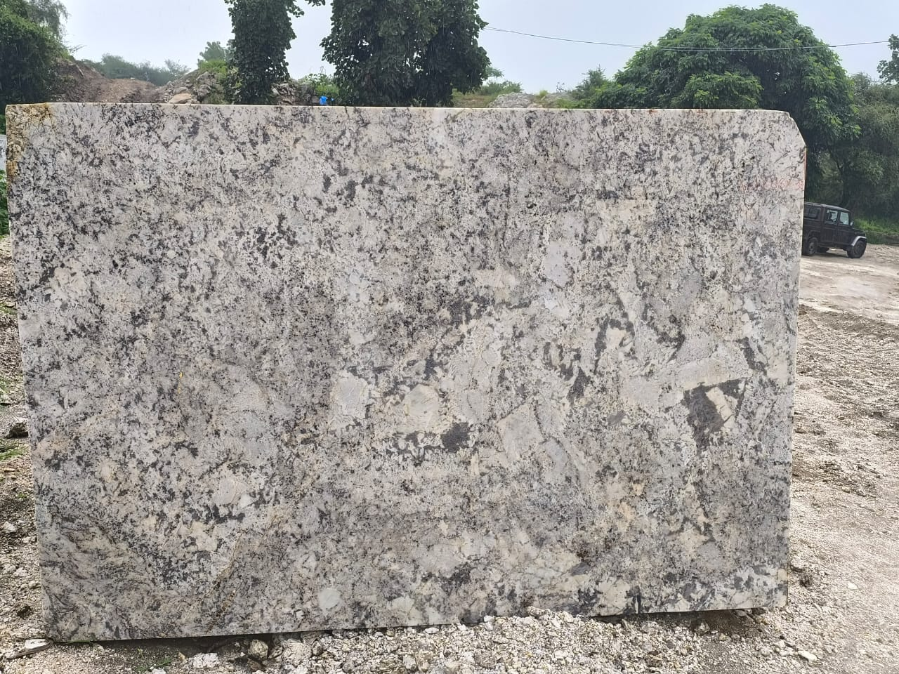
Alaska White

Slide 12
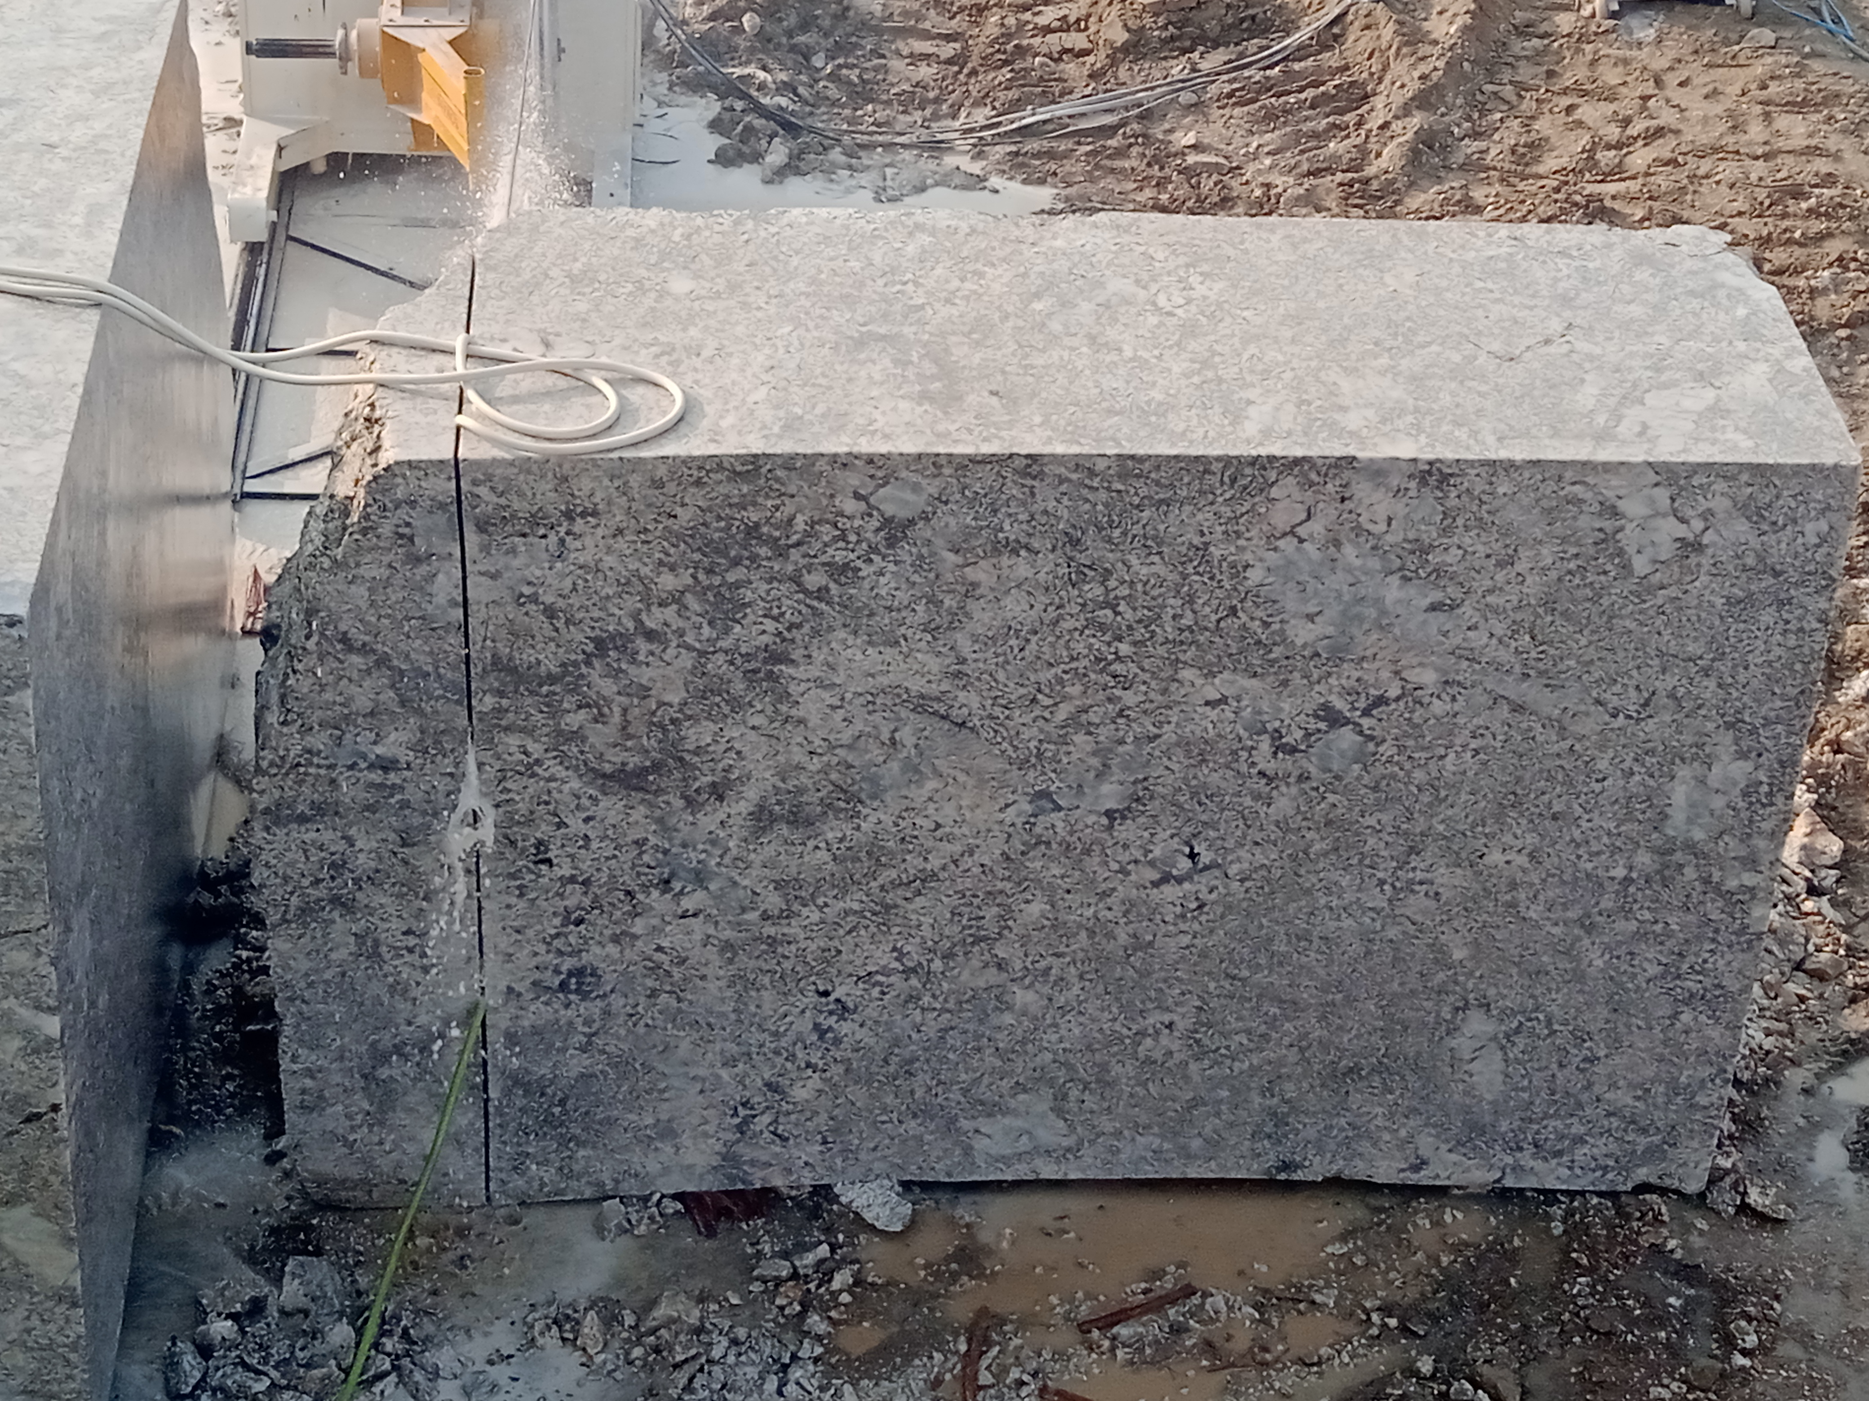
Alaska White

Slide 13
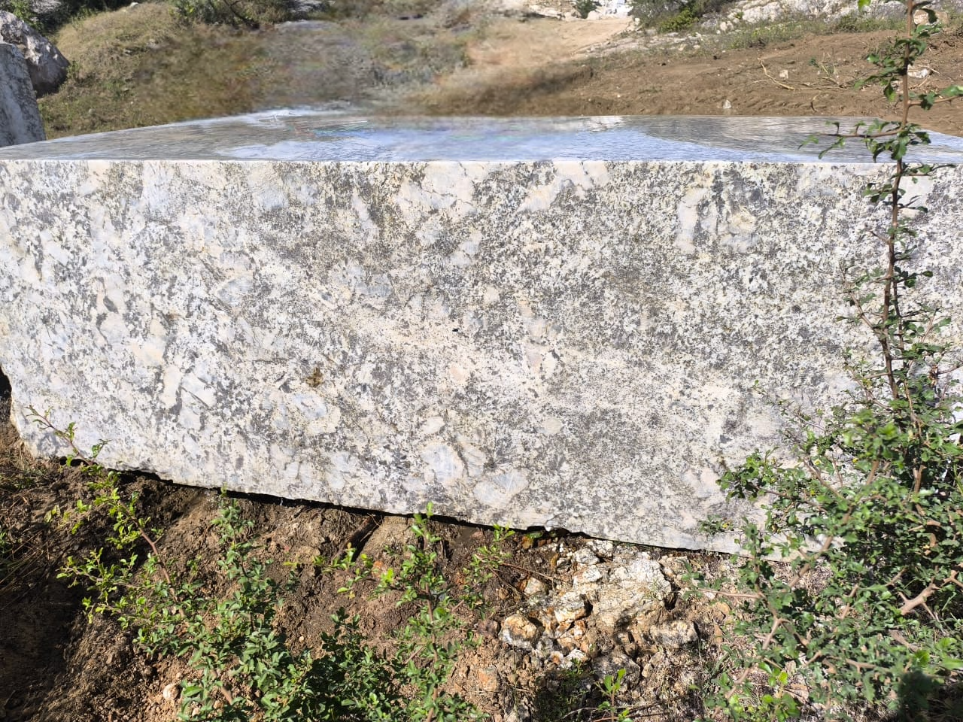
Alaska White

Slide 14
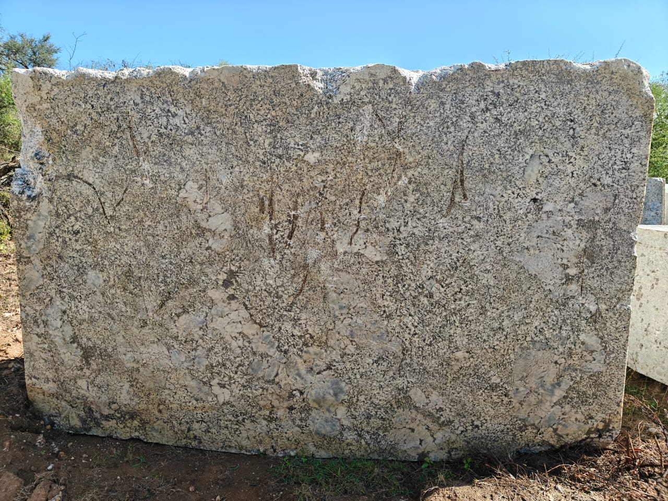
Alaska White

Slide 15
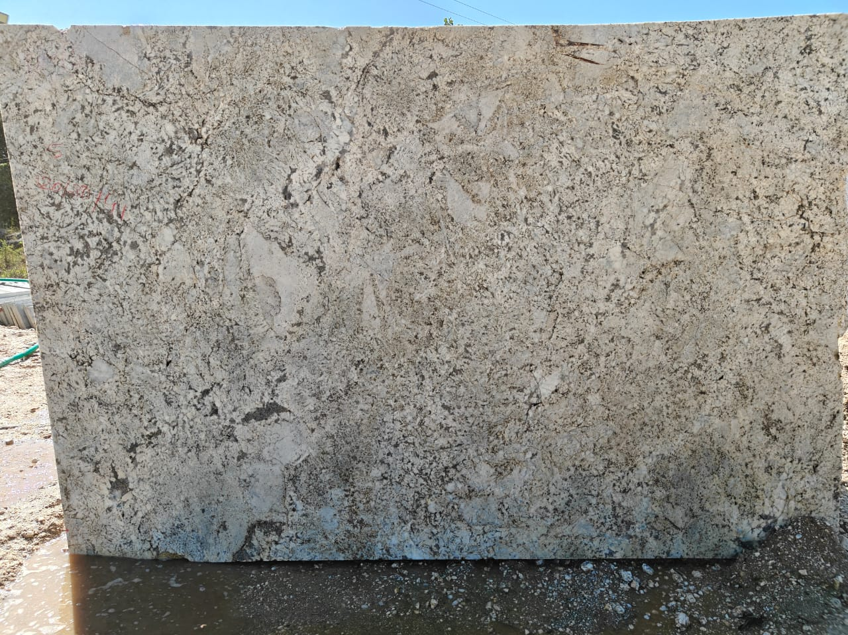
Alaska White

Slide 16
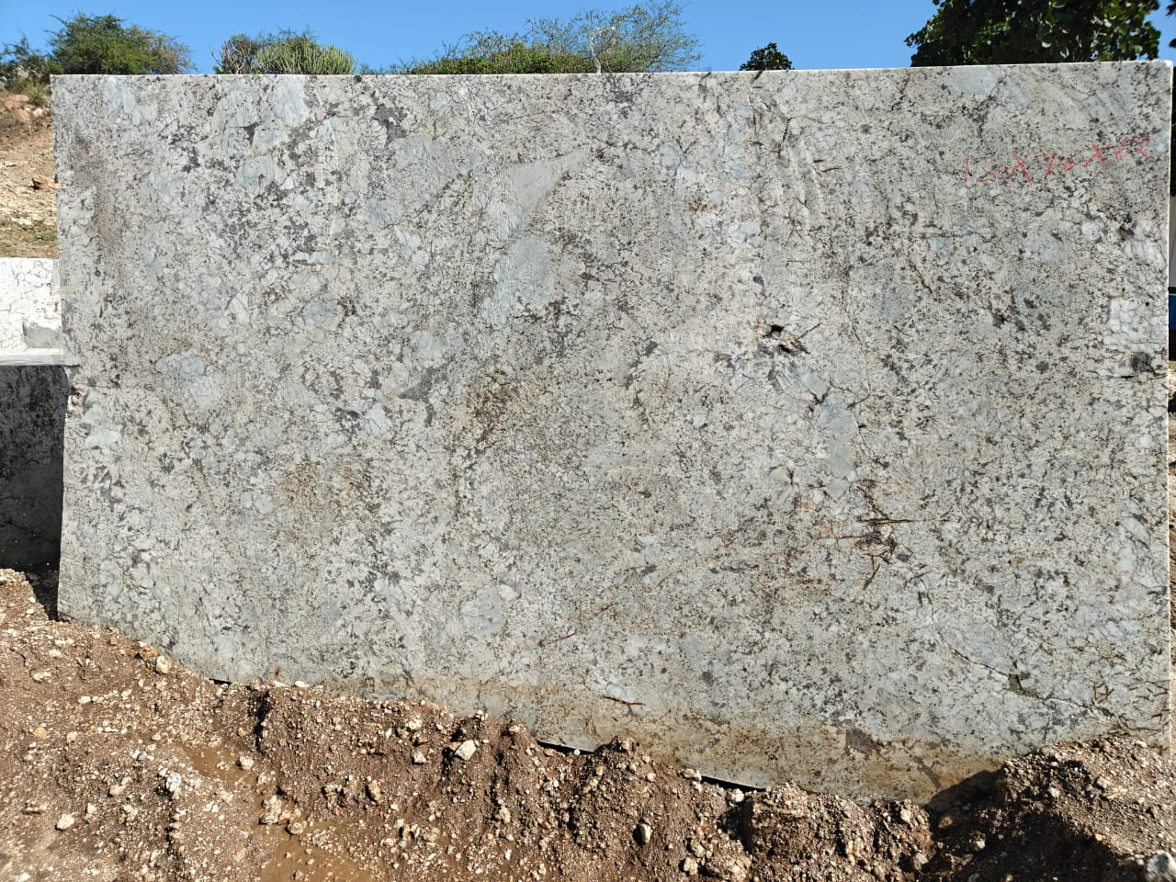
Alaska White

Slide 17
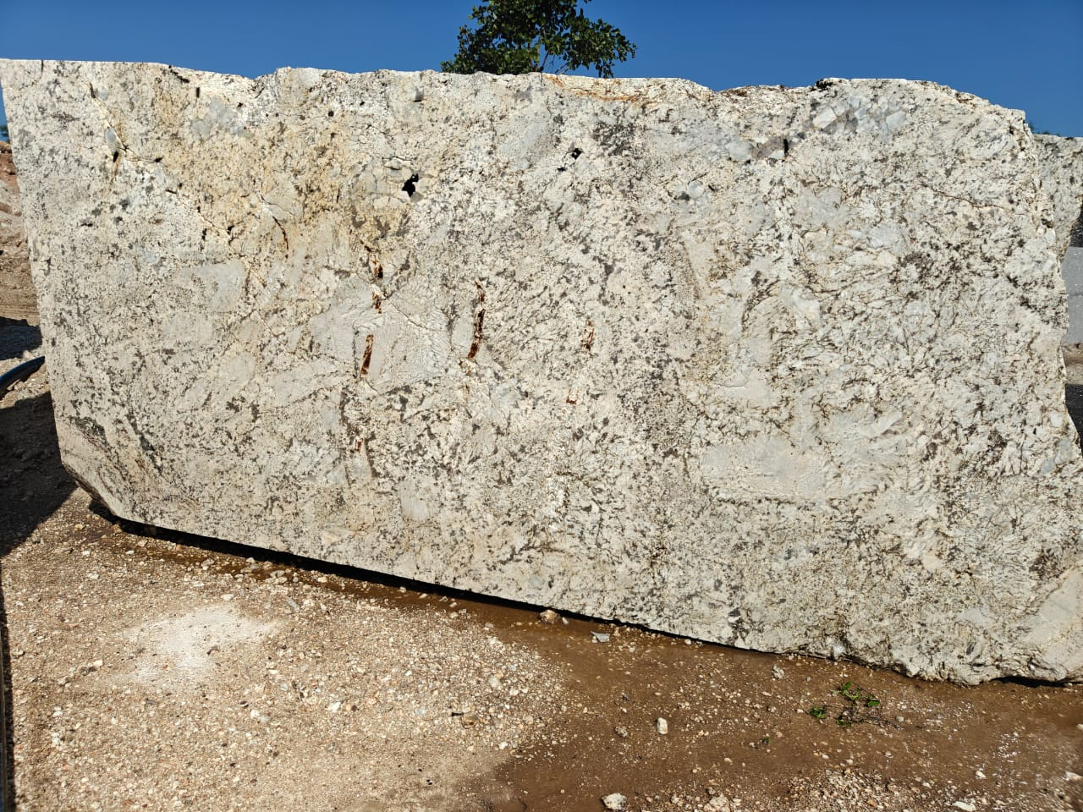
Alaska White

Slide 18
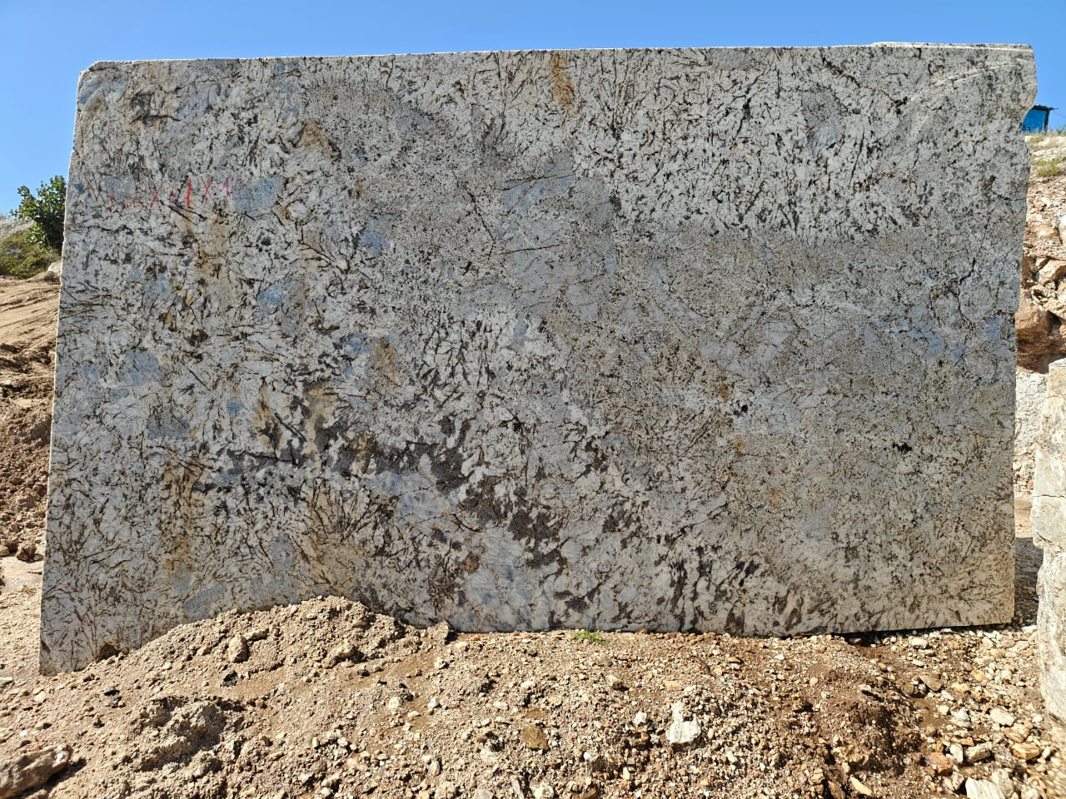
Alaska White

Slide 19
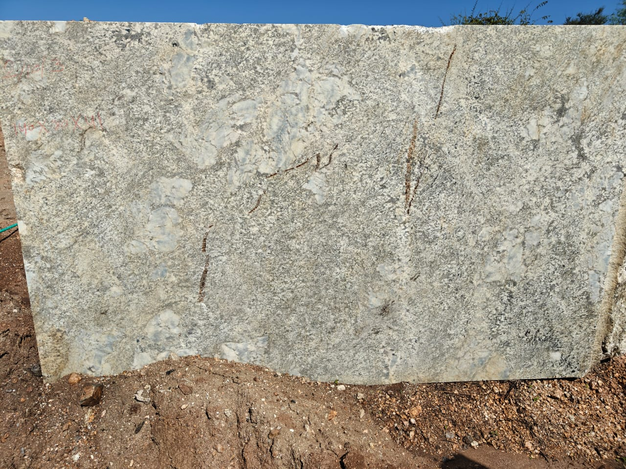
Alaska White

Slide 20
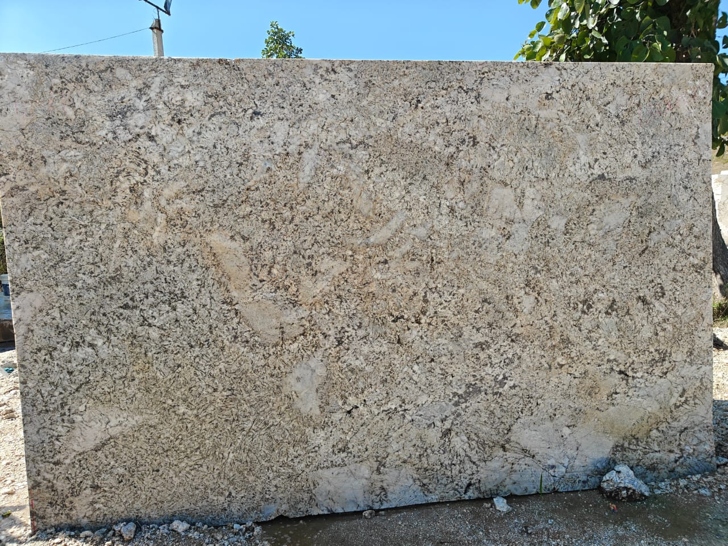
Alaska White

Slide 21
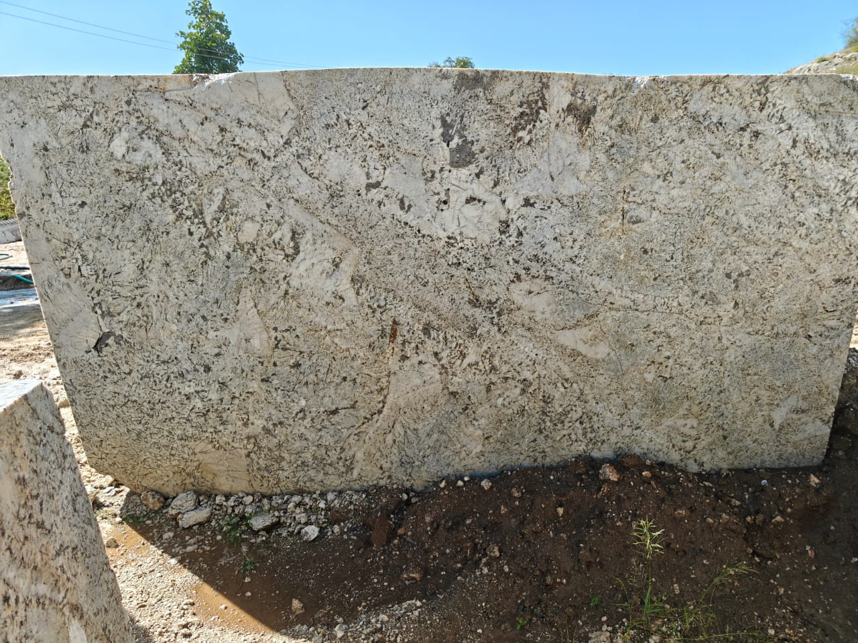
Alaska White

Slide 22
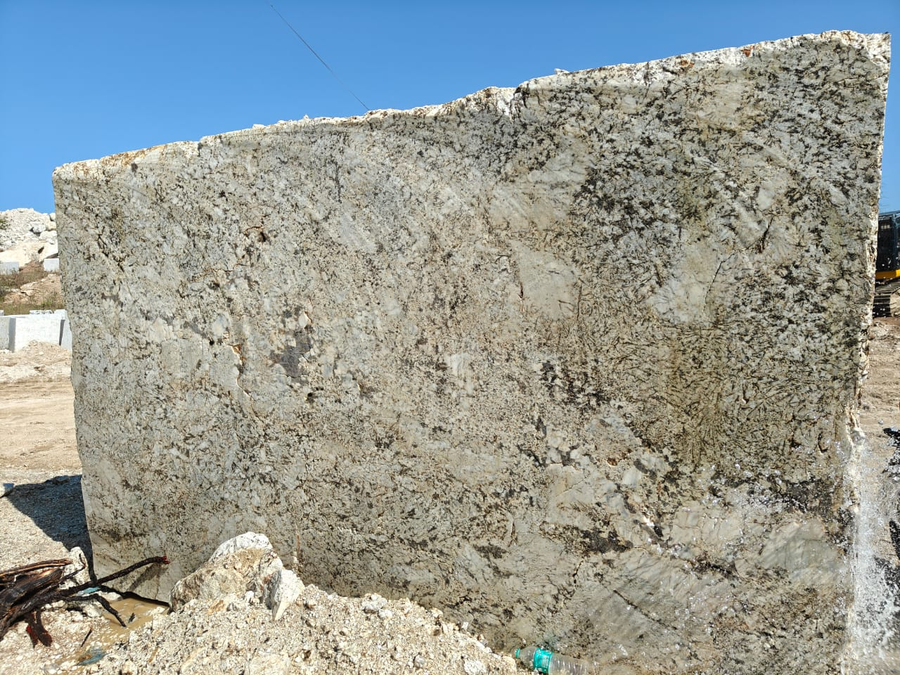
Alaska White

Slide 23
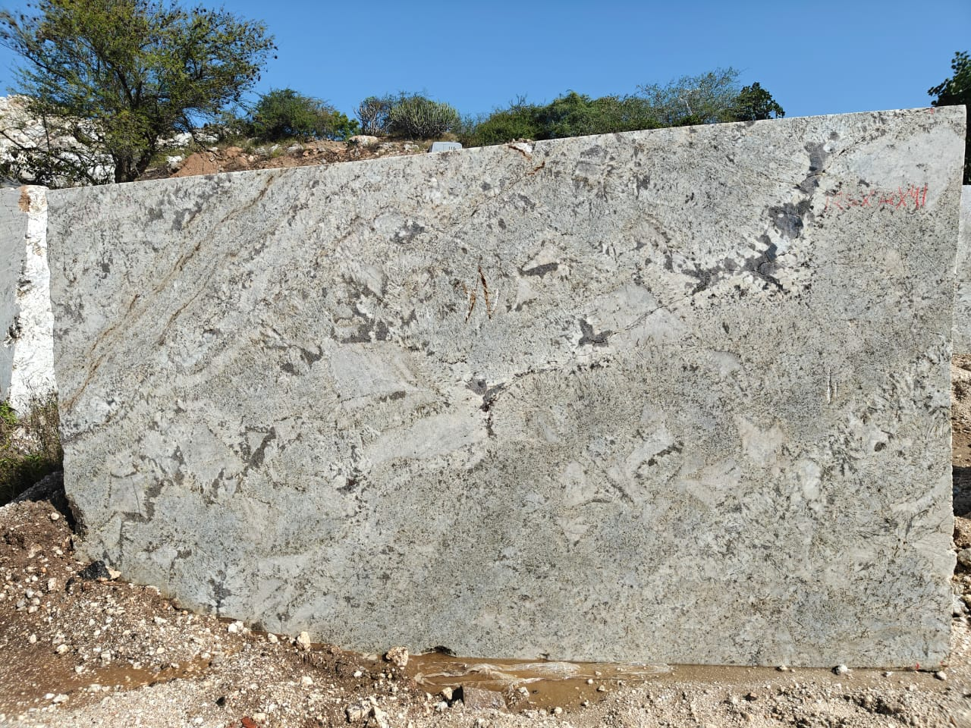
Alaska White

Slide 24
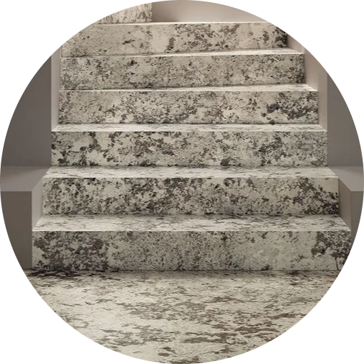
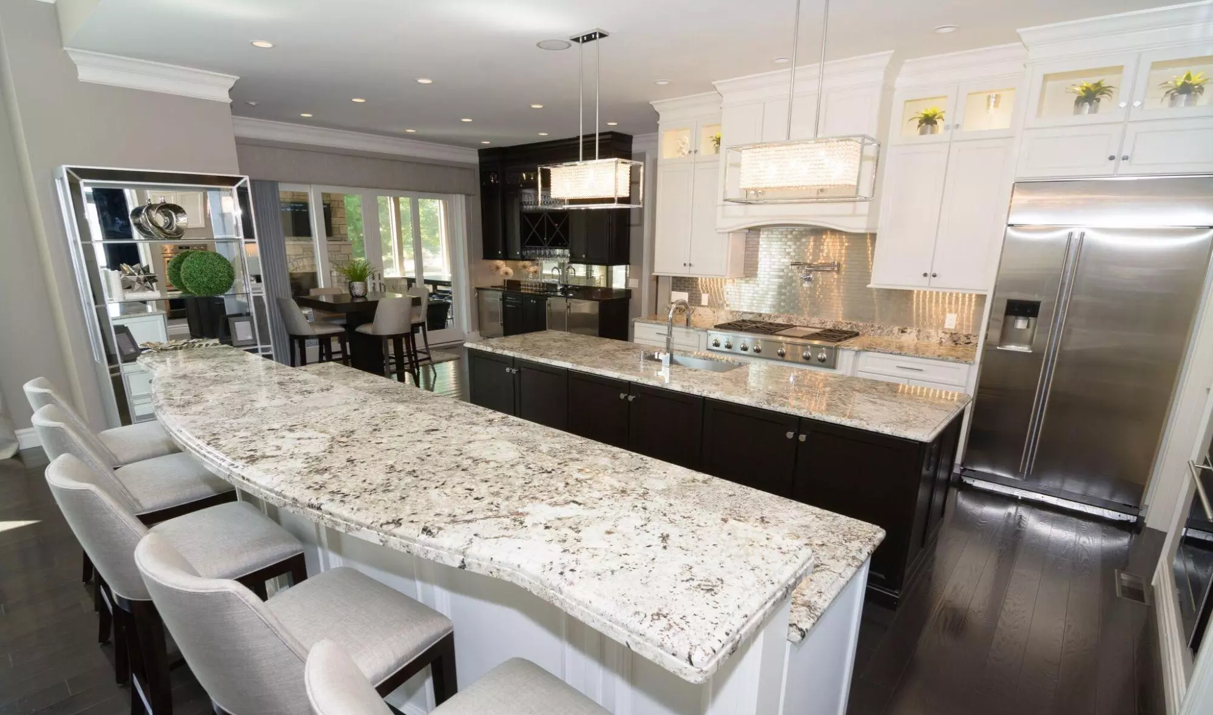
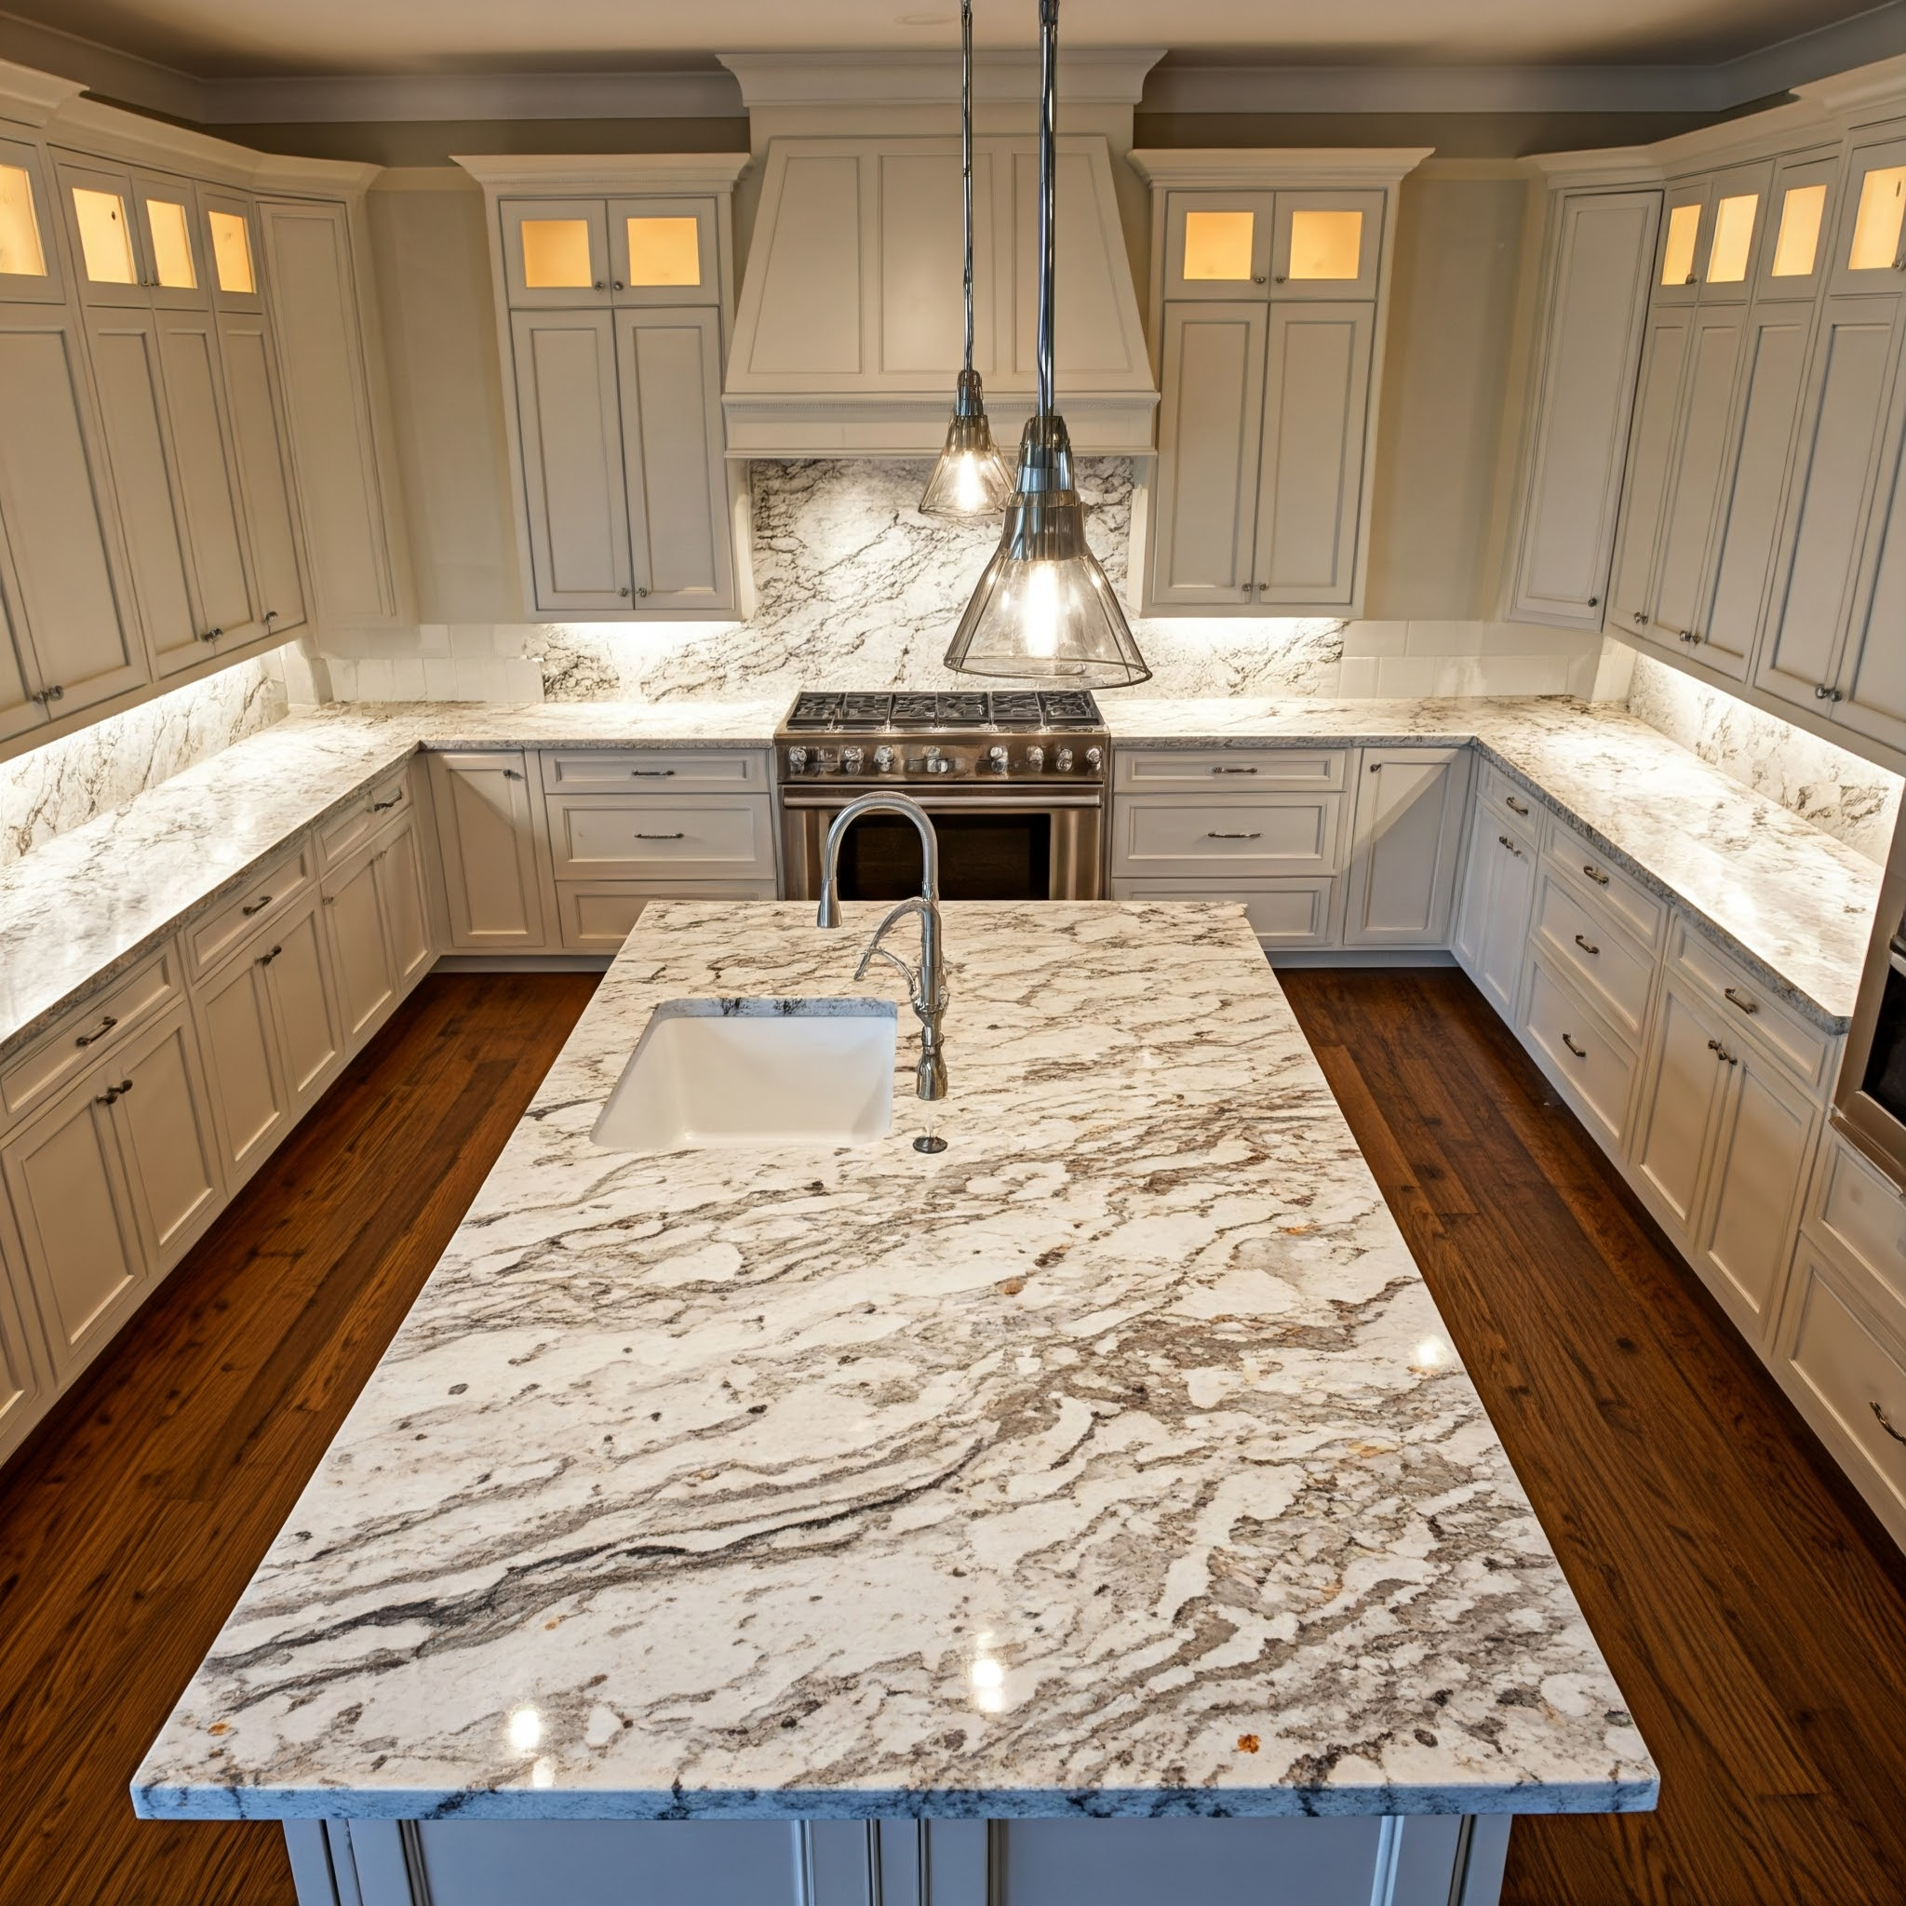
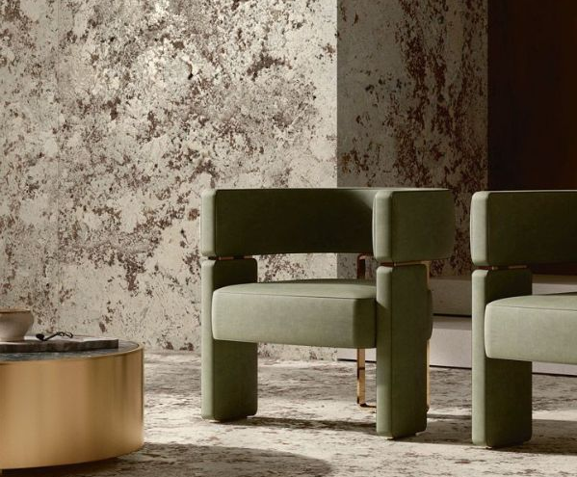
Alaska White Applications

Slide 25
Alaska Pink is a natural stone with a light pink base and grey, white, and black speckles. It is mainly quarried in India and is known for its strength, durability, and attractive appearance.
Due to its low water absorption and resistance to heat and scratches, it is widely used for flooring, countertops, wall cladding, and building facades in residential and commercial projects.

Slide 26
Alaska White features a light creamy white to pale grey base with elegant patterns of grey, beige, and black. Its flowing veins add depth and charm, making it ideal for countertops, backsplashes, and interiors.
Known for its durability, heat, and scratch resistance, it combines timeless elegance with lasting performance.

Slide 27
Why Choose our Product
Premium grade sourced directly from our mines
High gloss and durability ideal for export quality slabs
Uniform texture with natural veining and superior strength
Customized block sizes available as per client requirements
Backed by years of expertise in stone mining and processing

Slide 28

Contact us
M/s Kumar Herbals
Village- Narana P.O. - Narana
Teh- Deogarh Dist-Rajsamand, Pin-313332, Rajasthan
📞
Mr. Ravindra Gupta: +91 8209752868
Mr. Munesh Sainger: +91 8630882069
Mr. Suraj Chandola: +91 7817000042
✉
ravindra-gupta@Lscinfraetch.com
munesh@lscinfratech.com
surajchandola@lscinfratech.com

Slide 29
Our strength lies in
Quality
Consistency
Lasting relationships
With warm regards
Kumar Herbals

